Slide 1
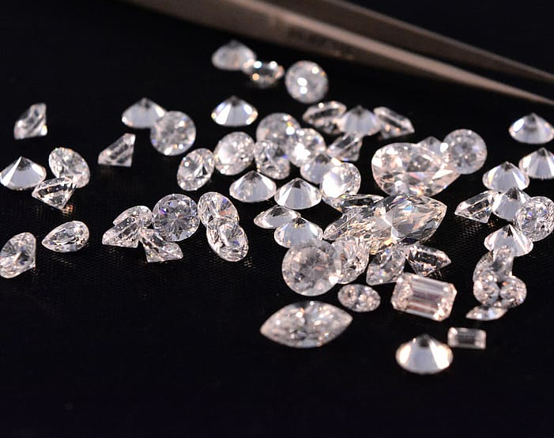
Introduction to A.I powered solutions for Gemstone Industry Challenges
Anu Gamage Research Scientist Sul's Research Group

Slide 2
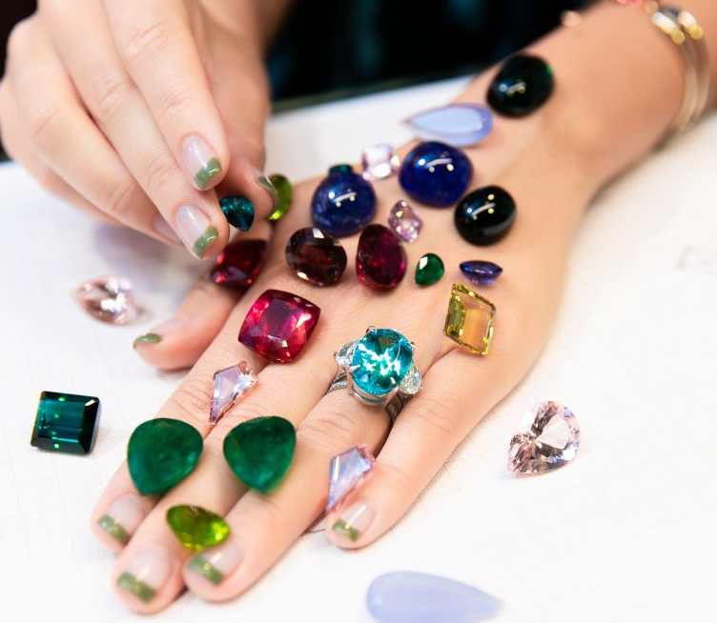

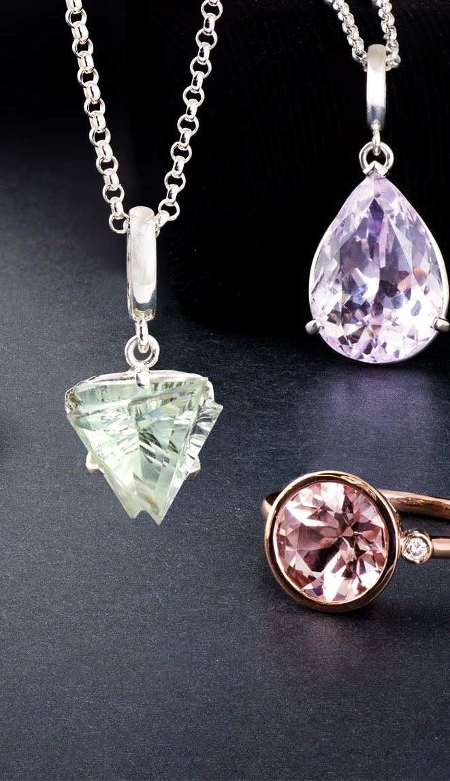
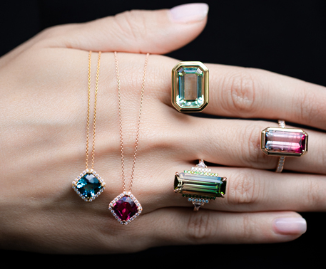
Wanna Know?

Slide 3
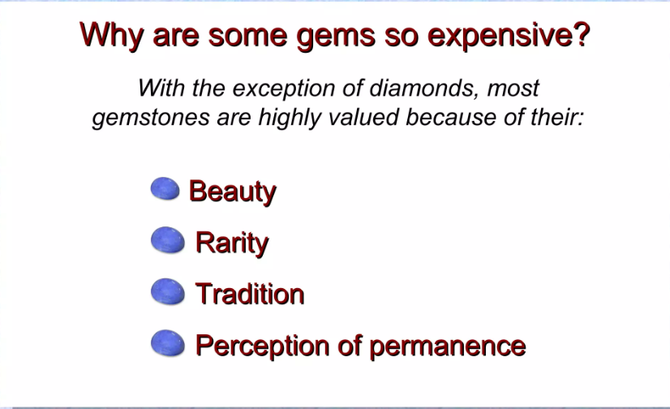

Slide 4
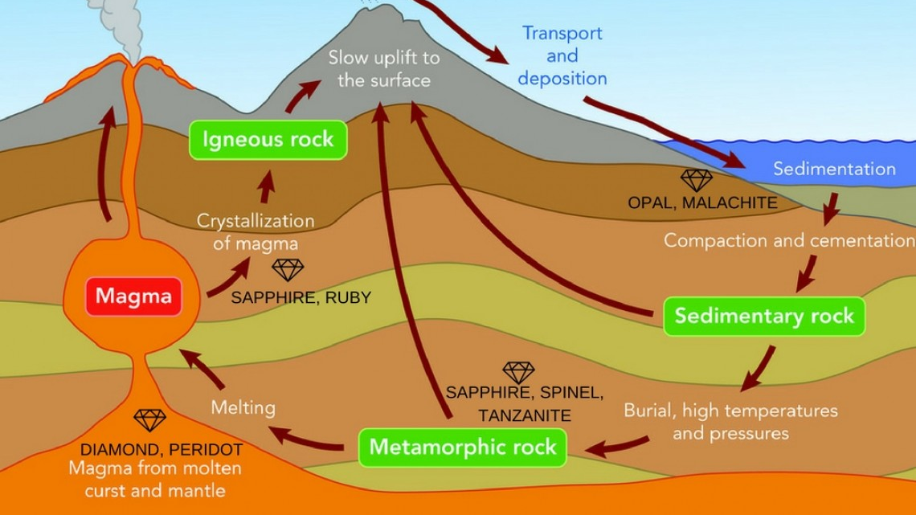

Slide 5
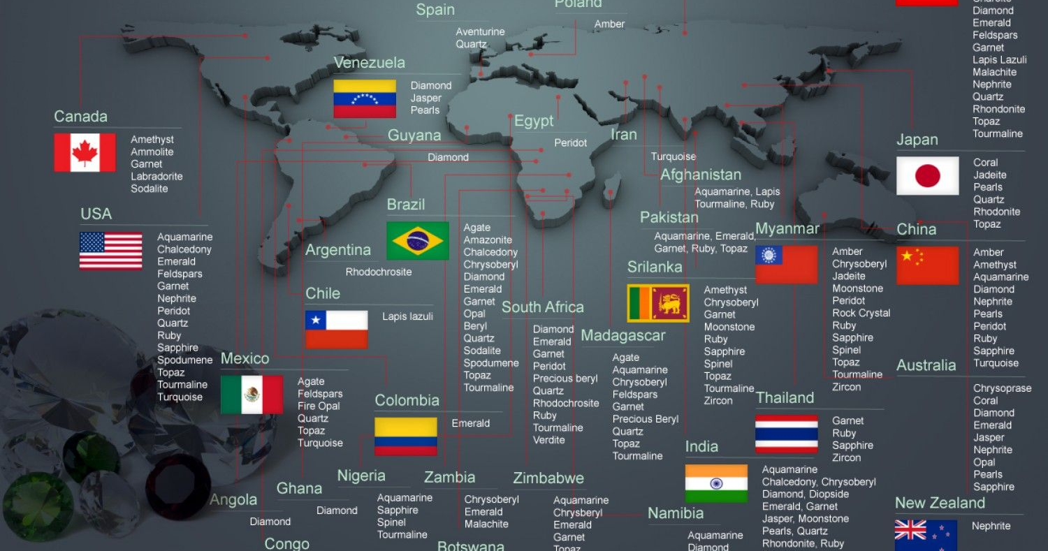

Slide 6
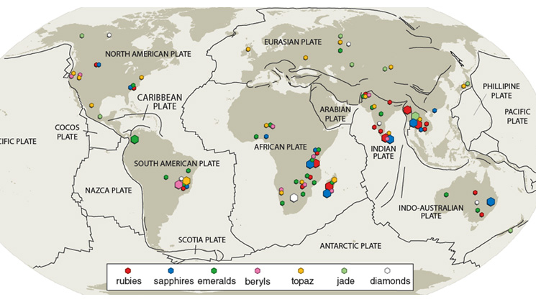

Slide 7
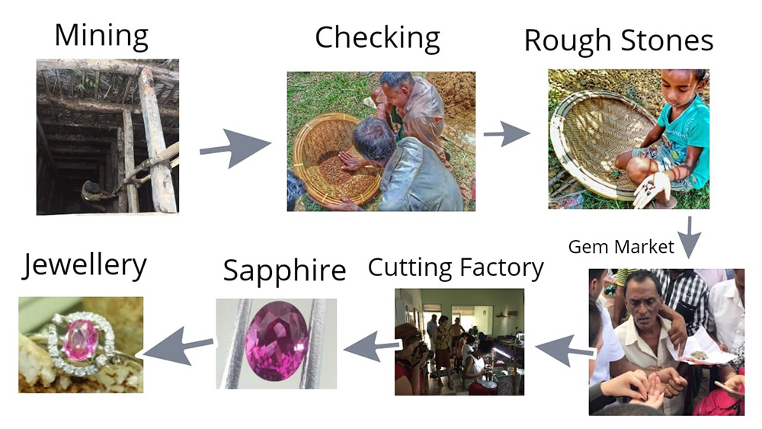

Slide 8
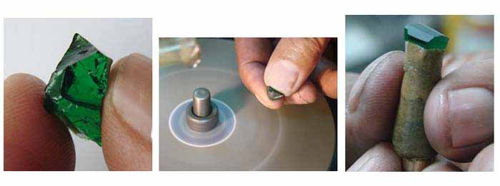

Slide 9
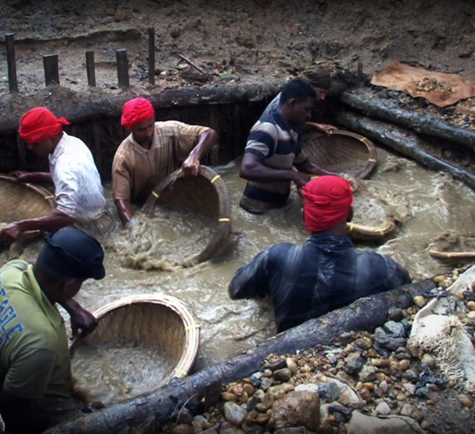
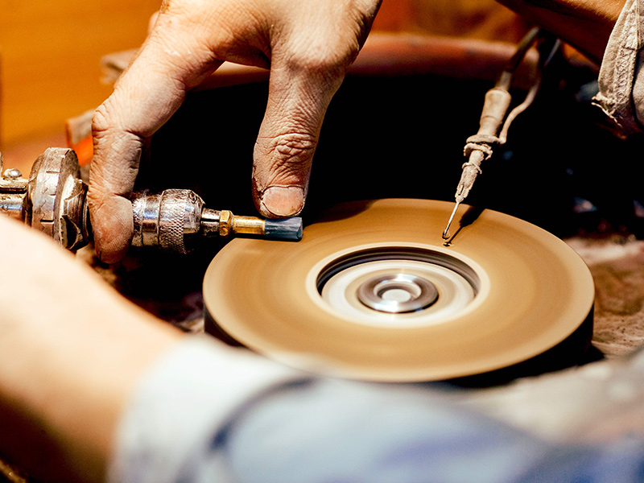
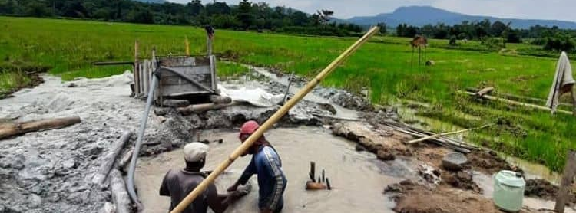

Slide 10
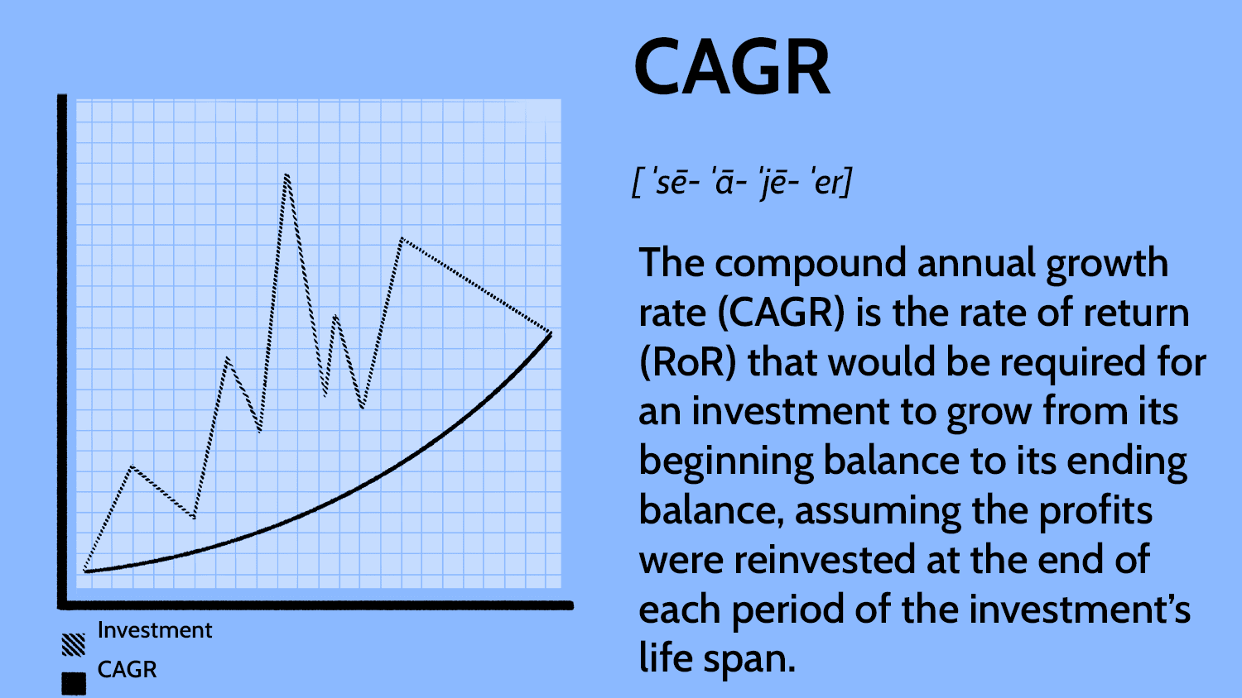

Slide 11
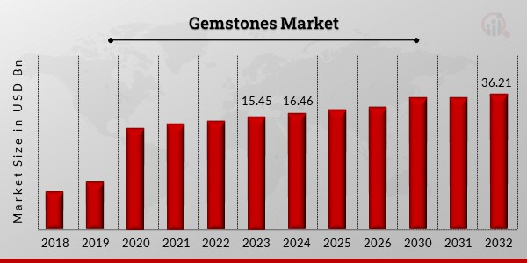

Slide 12
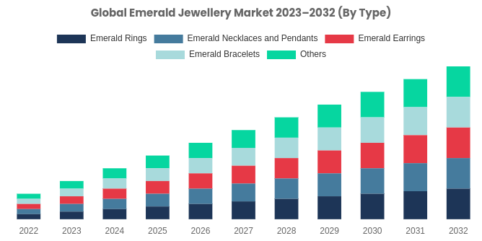

Slide 13
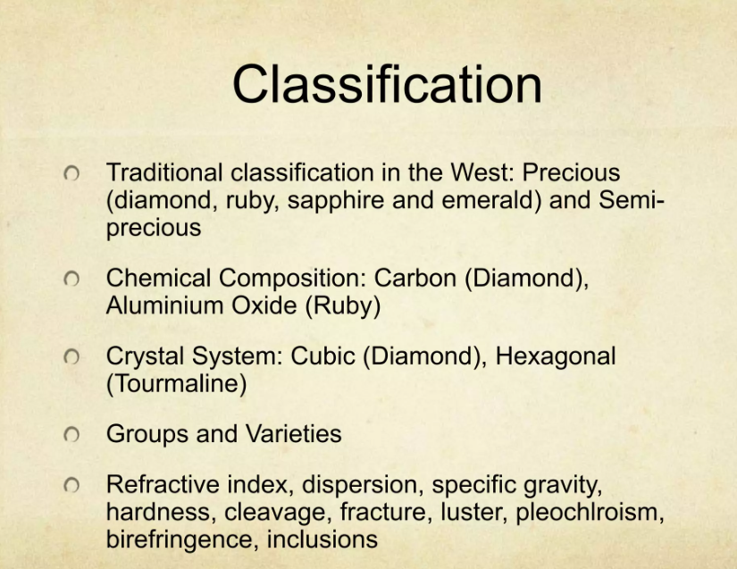

Slide 14
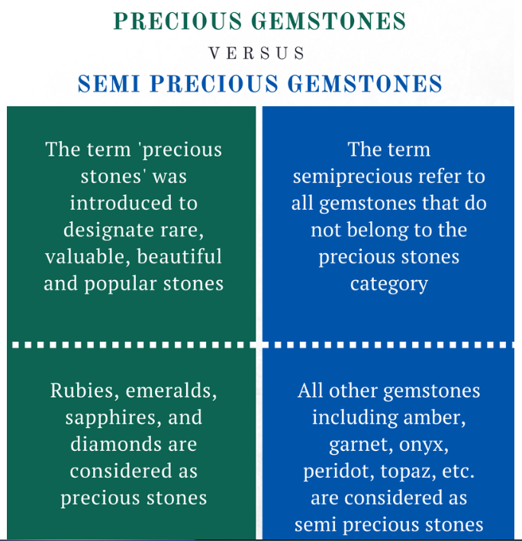

Slide 15
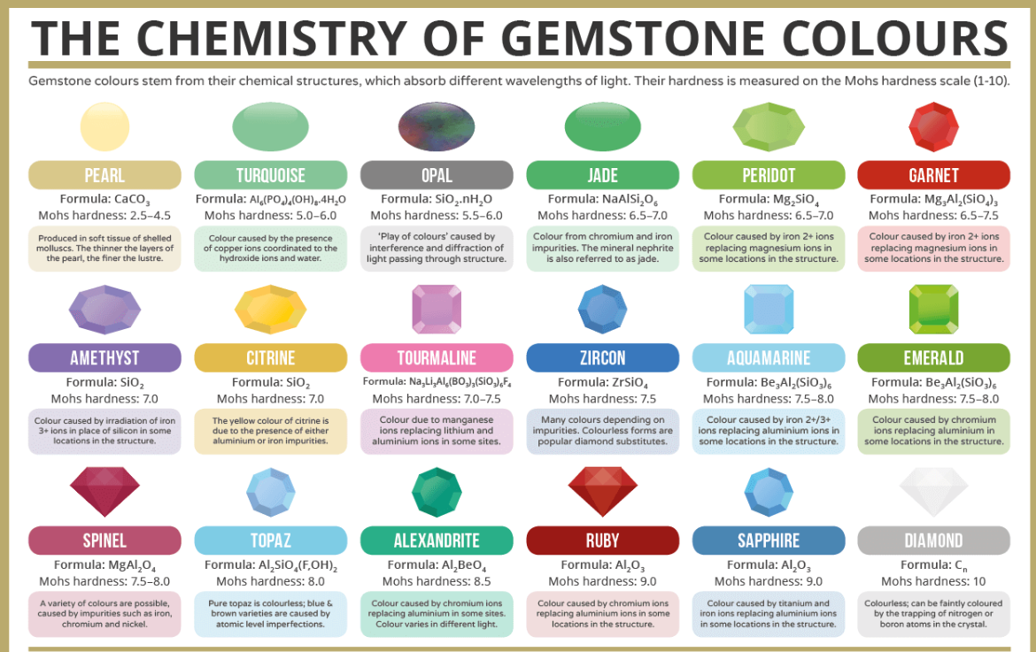

Slide 16
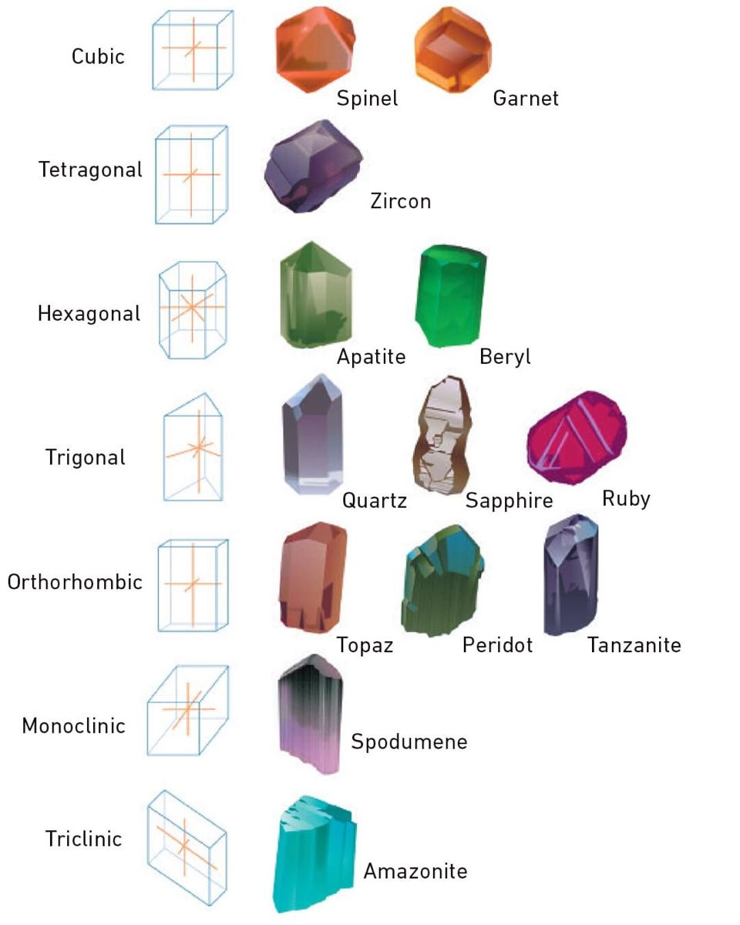
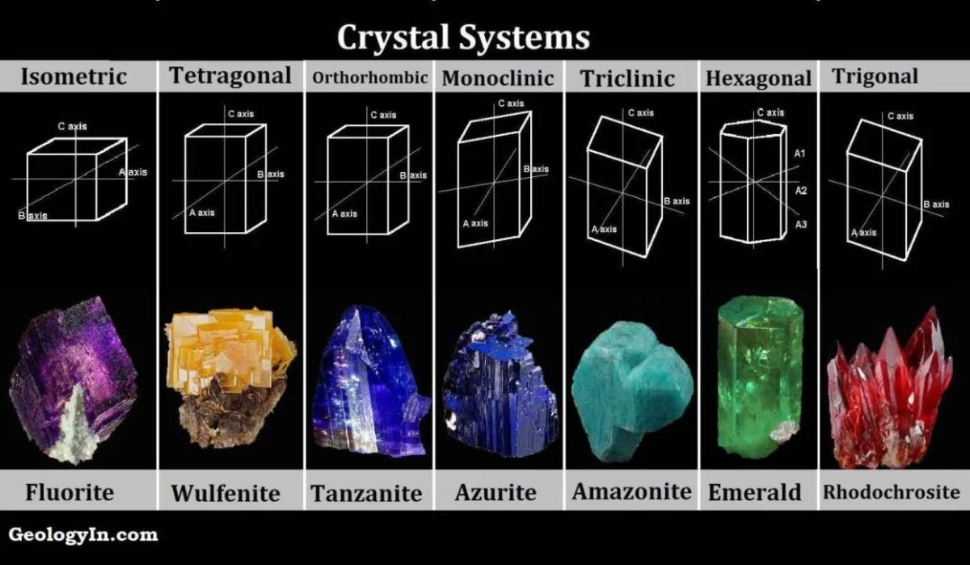

Slide 17
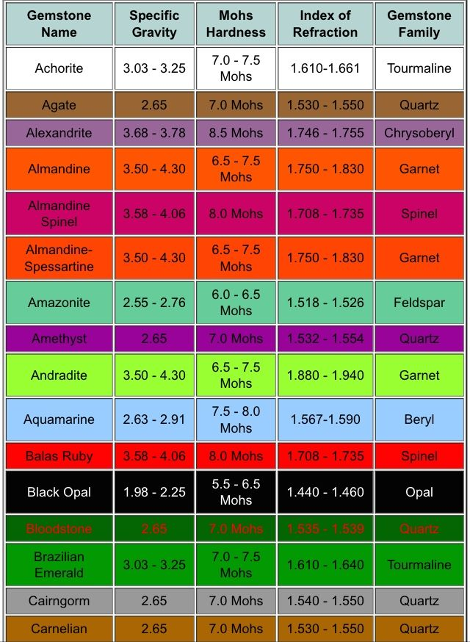

Slide 18
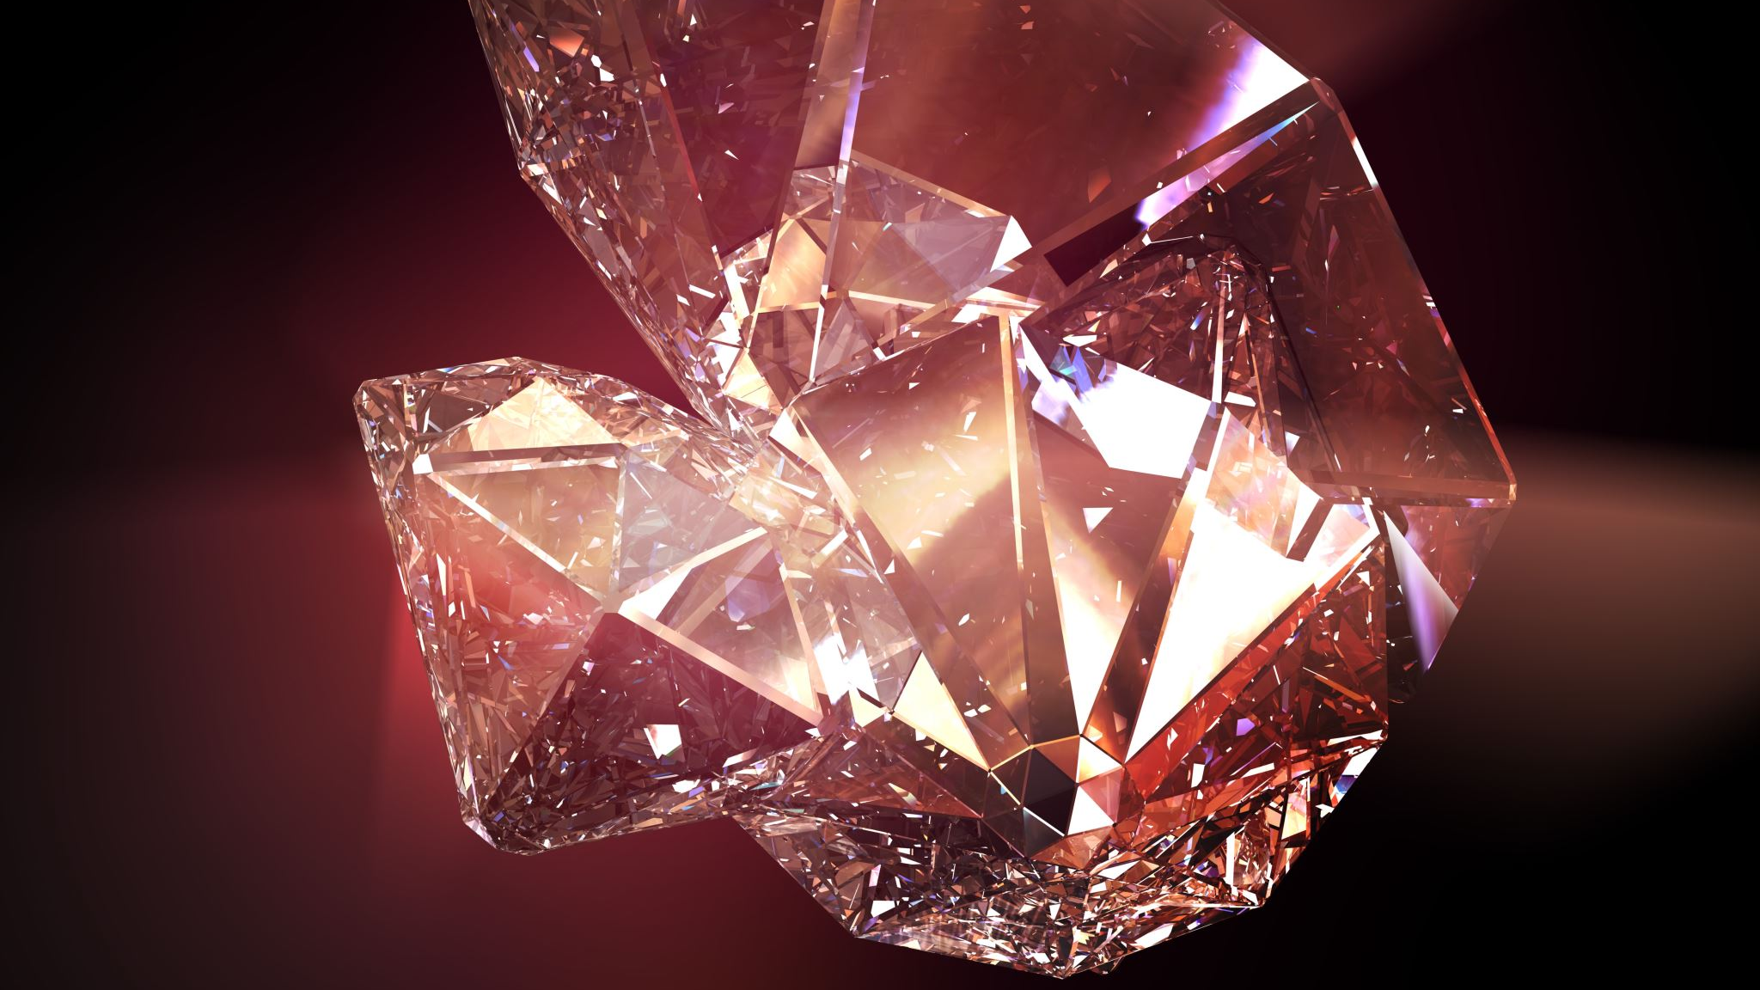
Gemstone Families

Slide 19
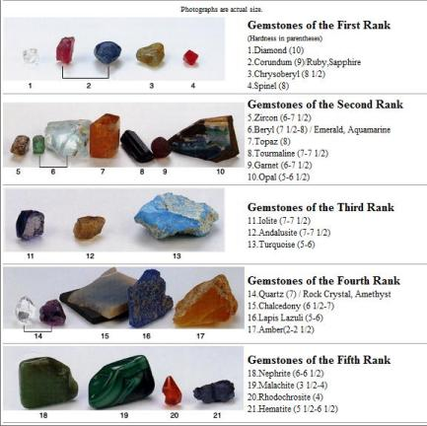
Gemstone Families

Slide 20
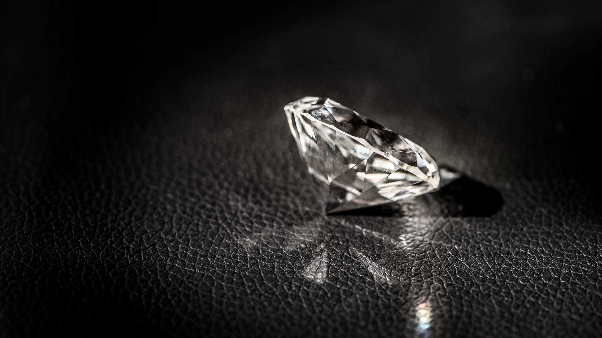
Uses of gemstones other than jewelry

Slide 21
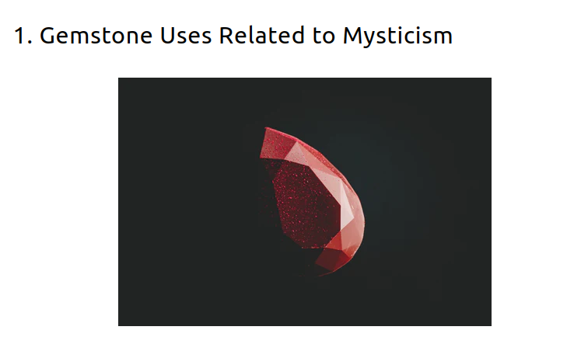
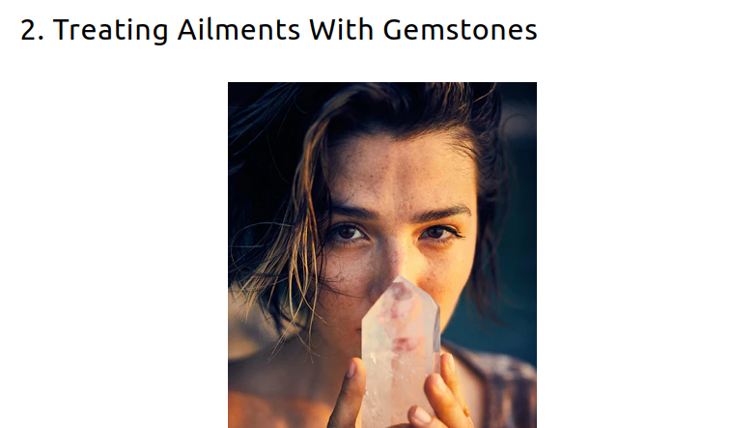
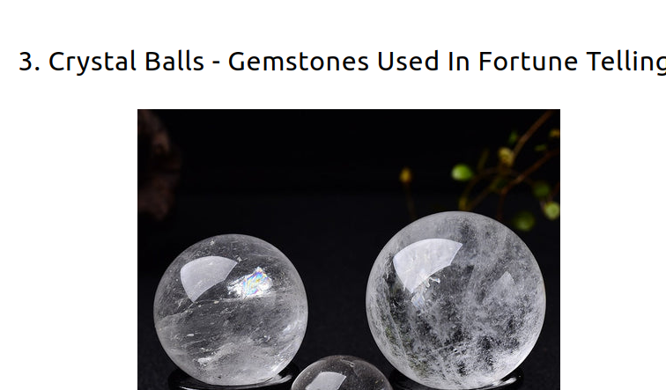
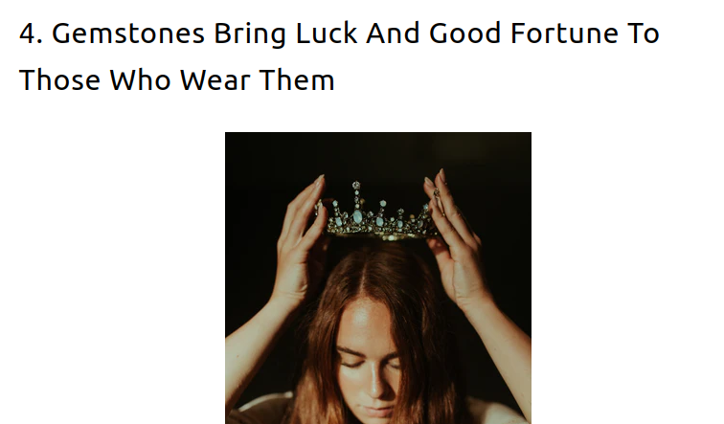

Slide 22
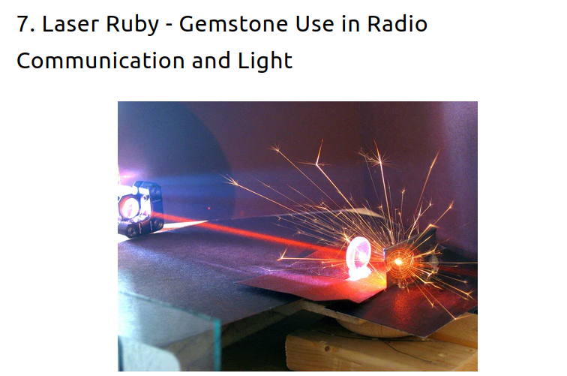
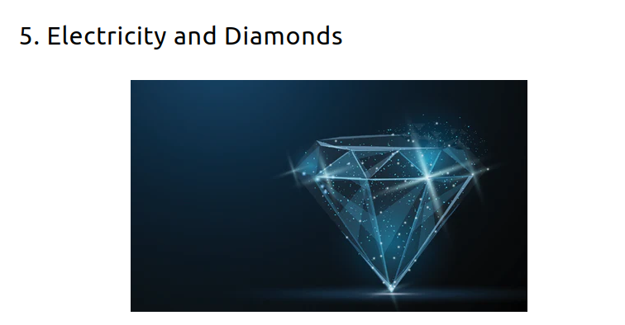
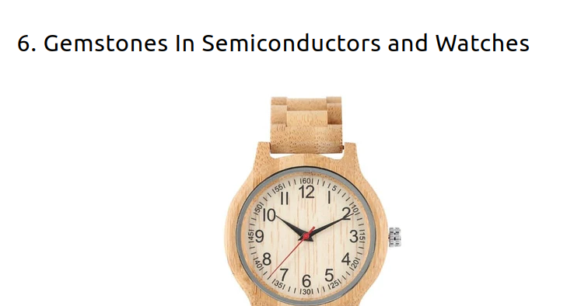
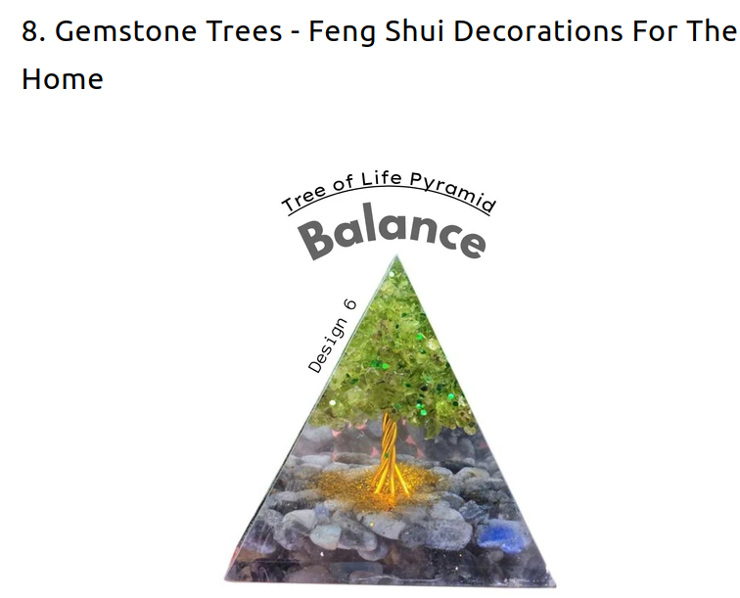
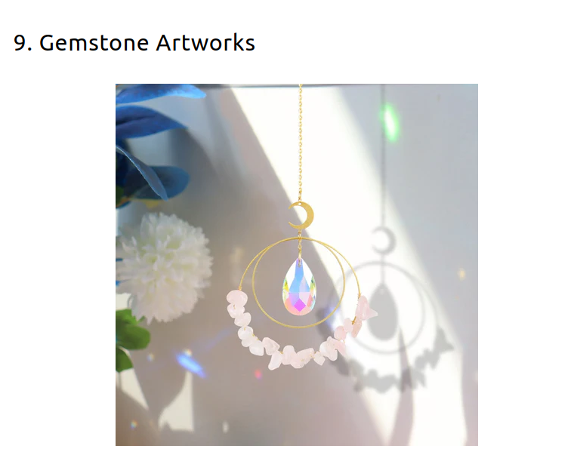
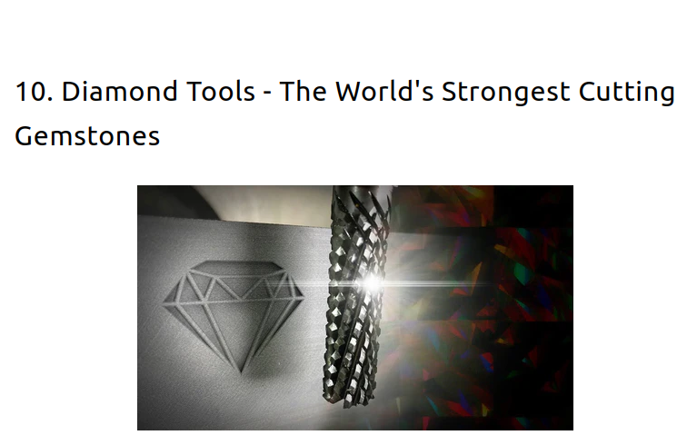

Slide 23
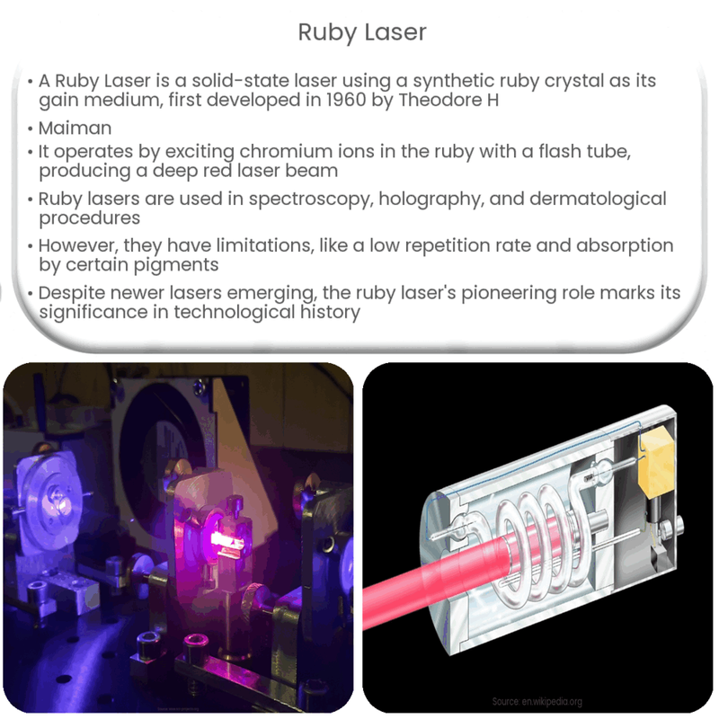

Slide 24
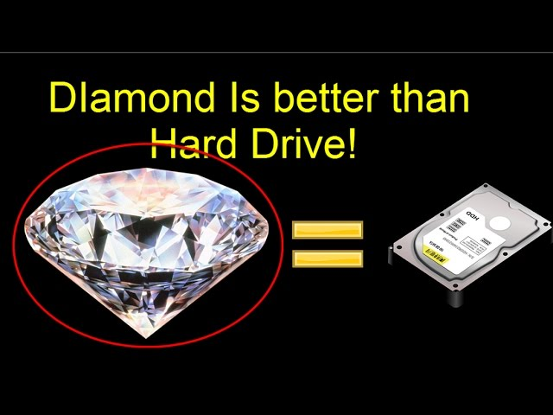
Typical Blu-ray disc can store up to 25 GB of data. Therefore, a billion Blu-ray discs would equate to a staggering 25 exabytes of data.

Slide 25
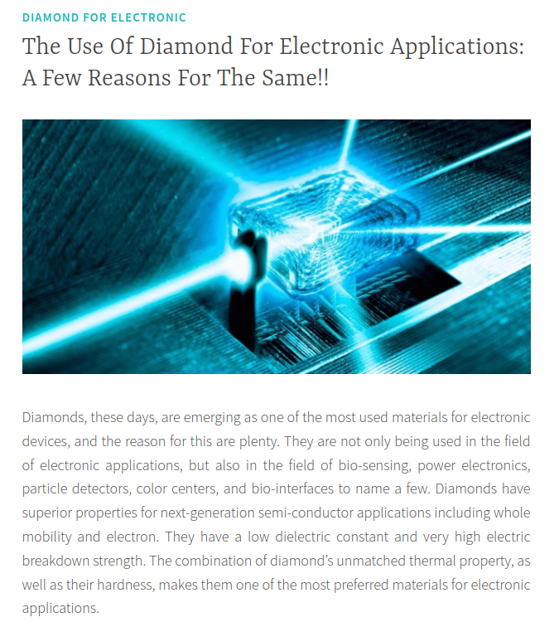
Worth Studying ?

Slide 26

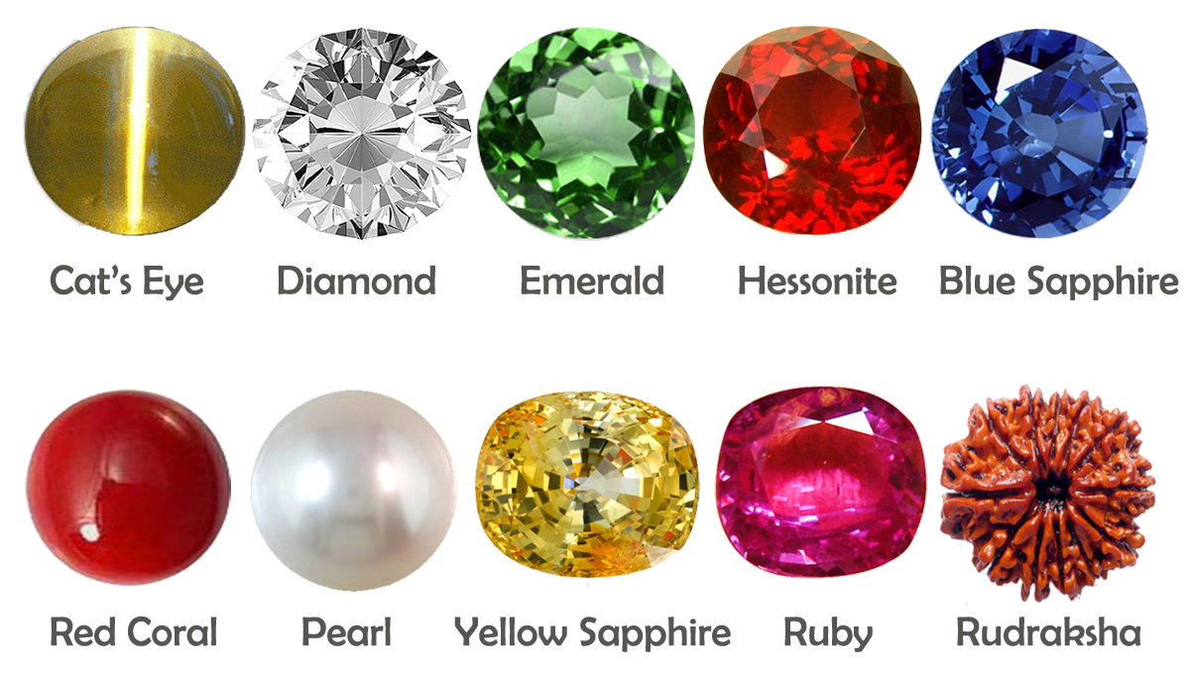
Gemstones in Electronics
Semiconductors
Piezoelectric Devices
Optoelectronics
Medical Applications
Diagnostics
Therapeutic Uses
Emerging Technologies
Quantum Computing
Renewable Energy
Wearable Technology
Industrial Applications
Cutting and Drilling
Abrasives
High-Pressure Research
Worth doing research!

Slide 27
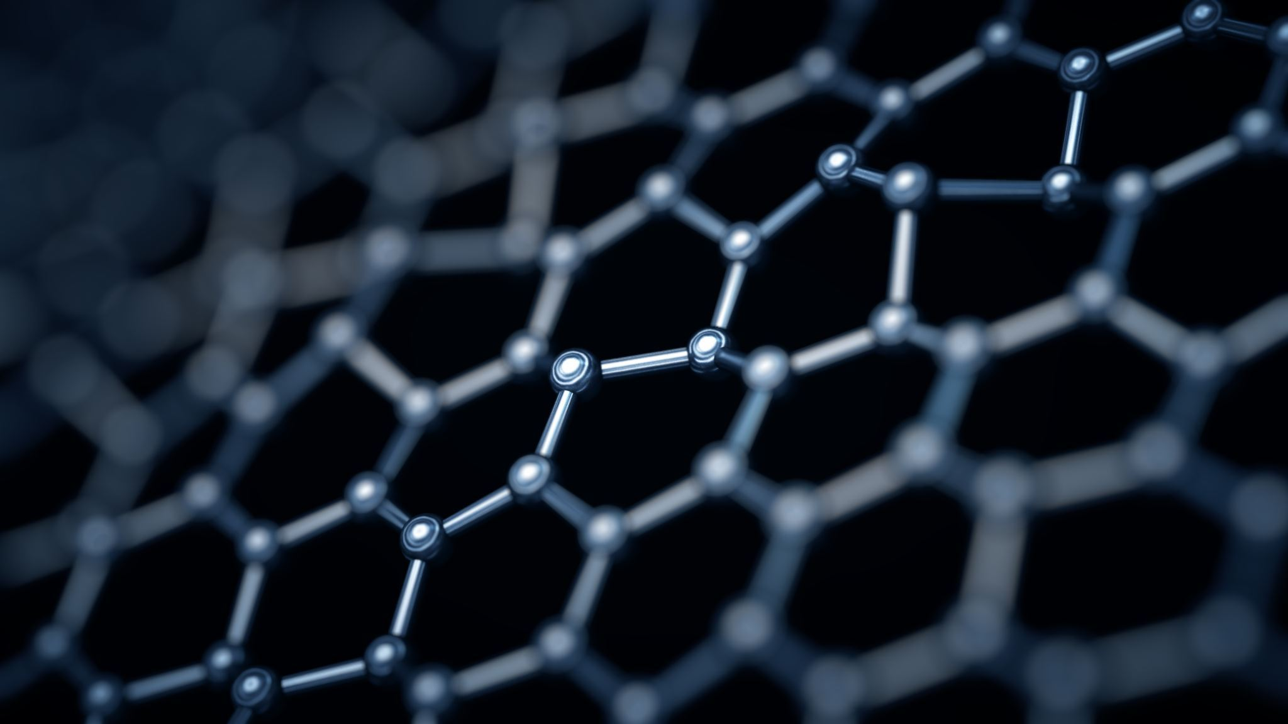
Gemstones Identification Methods

Slide 28
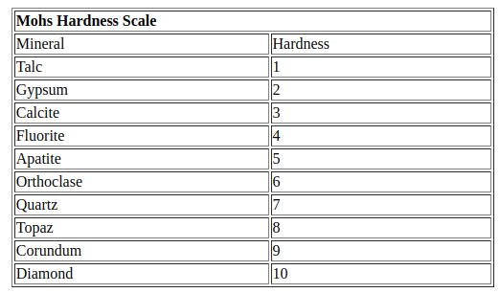
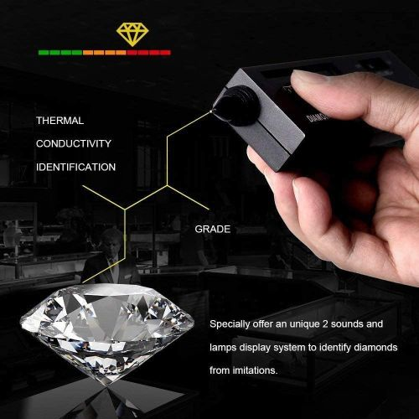
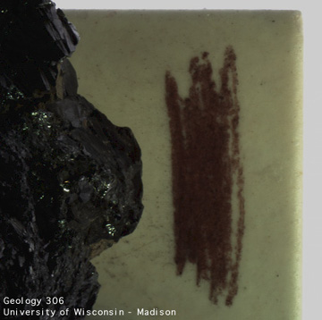
Hardness
Streak

Slide 29
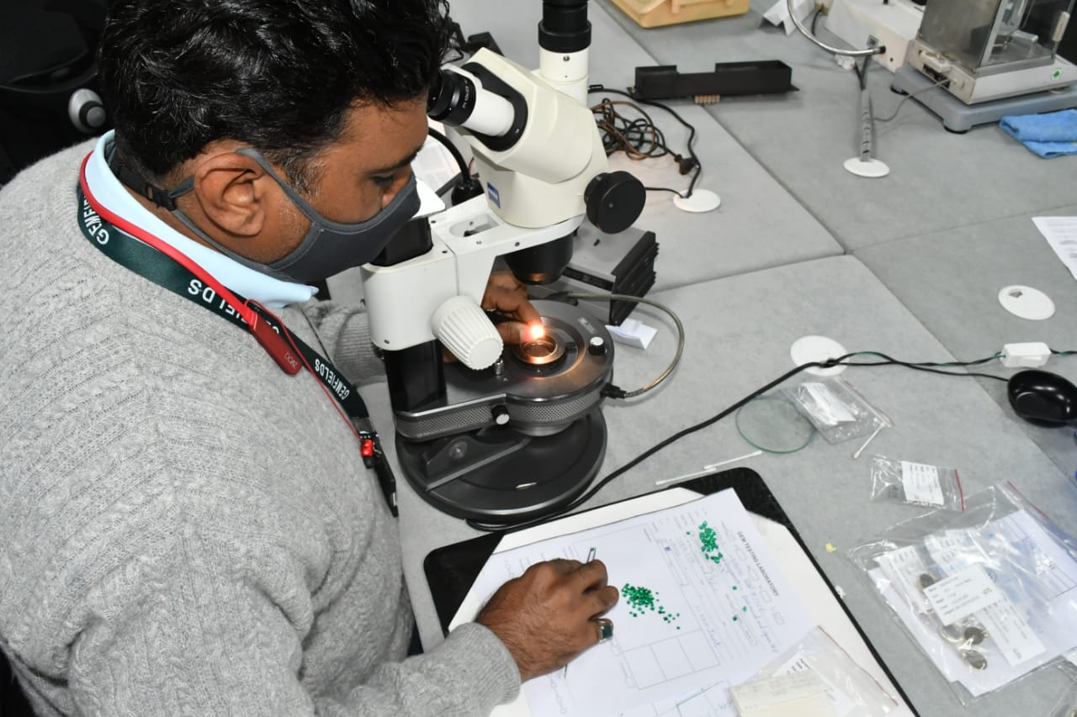
Crystal Morphology and Color
Optical behavior is subdivided into three types:
Isotropic: material always remains dark under cross polarized light
Anisotropic: light passes through the crystal as it is rotated under crossed polars.
If, as it is rotated about one specific axis (only), the crystal remains dark, then the gem is termed "uniaxial."
If two specific axes can be found where the crystal remains dark while rotated between two crossed polars, the crystal is termed "biaxial."
Gems are classified firstly on isotropic, uniaxial, or biaxial categories, and then into more specific crystal systems.

Slide 30
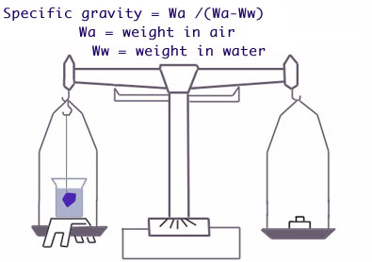
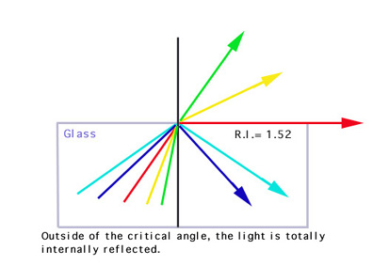
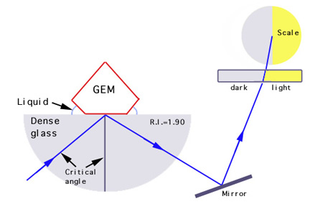
Specific Gravity
Refractive Index and Dispersion

Slide 31
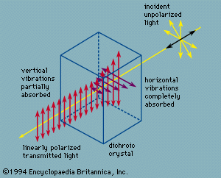
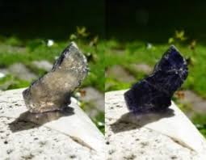
Pleochroism

Slide 32
Spectroscopic techniques
1. Fourier Transform Infrared Spectroscopy

Slide 33
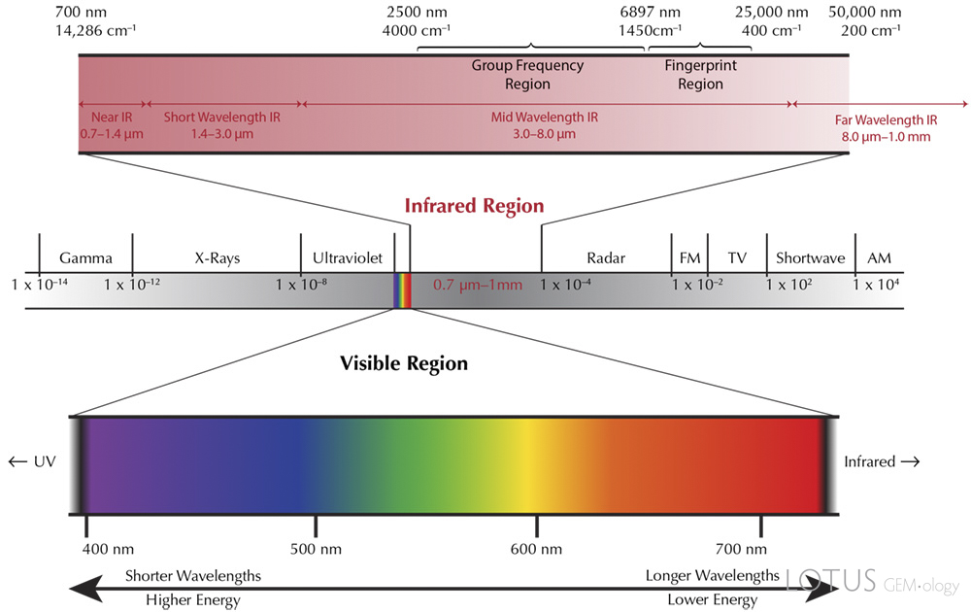

Slide 34


Slide 35


Slide 36


Slide 37
Advantage 1. Diamond Classification 2. Detection of Boron in Diamonds 3. Detection of Treatments 4. Identification of Heating in Corundum 5. Synthetic vs. Natural Gemstones 6. Identification of Synthetic Amethyst 7. Distinguishing Synthetic Flux Alexandrite 8. Amber and Copal Differentiation Disadvantages The sampling chamber of an FTIR can present some limitations due to its relatively small size. 2. Mounted pieces can obstruct the IR beam. Usually, only small items as rings can be tested. 3. Several materials completely absorb Infrared radiation; consequently, it may be impossible to get a reliable result.

Slide 38
Spectroscopic techniques
2. Raman spectroscopy

Slide 39


Slide 40



Slide 41

Photons

Slide 42


Slide 43





Slide 44



Slide 45


Slide 46
Advantage : 1. Single Tool Efficiency : Raman spectroscopy can identify rough, polished, loose, or mounted gems without needing multiple confirmations, simplifying the identification process. 2. Accuracy and Precision : The Raman fingerprint is exceptionally accurate and precise, making further analysis unnecessary for conclusive results. 3. Non-Invasiveness : As a non-destructive technique, Raman spectroscopy does not damage the gem being analyzed, preserving its integrity. 4. No Sample Preparation : There is no need for extensive sample preparation, making the process quicker and more convenient. 5. Speed : Raman spectroscopy provides rapid results, which is advantageous in a fast-paced industry like gemology. 6. Metal Compatibility : Since metals do not produce Raman signals, the technique is particularly useful for identifying mounted gems without interference. 7. Detection of Treatments : Raman spectroscopy can detect treatments such as infiltration with foreign substances, crucial for identifying gems enhanced for clarity or color using fillers like cedarwood oil or polymers. 8. Inclusion Identification : The technique can identify inclusions within gems using confocal micro-Raman spectroscopy, providing insights into the gem's origin, authenticity, formation conditions, and treatments.

Slide 47
Disadvantage : It is problematical to obtain an accurate Raman spectrum on amorphous materials due to the lack of their crystalline structure. Most natural and synthetic gems have the same “fingerprint”, so it is impossible to differentiate them with Raman spectroscopy, except for spinel and few others due to the slightly different chemical composition. Black materials can be difficult or impossible to identify because they tend to absorb their own Raman scattering. In most cases, the signal is so weak it is confused with the background noise of the spectrum.

Slide 48






Slide 49

What are synthetic gemstones ?

Slide 50

How CVD Diamonds and Hpht Diamonds Made?

Slide 51

Natural Quality?
Rarity ?
Natural Beauty?

Slide 52






NEWS

Slide 53



Communities

Slide 54

Problem?

Slide 55


Slide 56


Slide 57


Slide 58



Slide 59









Gemstone Samples
Spectrum Collecting
Ramen Spectroscopy
FTIR
Data Storage
Quantum Chemistry
Calculations
New Methodology
Artificial Intelligence for Analysis
1
Accurate Identification
Verified Certifications

Slide 60

References
https://www.imeko.org/publications/tc4-Archaeo-2020/IMEKO-TC4-MetroArchaeo2020-095.pdf
https://analyticalsciencejournals.onlinelibrary.wiley.com/doi/10.1002/jrs.5504
https://www.diva-portal.org/smash/get/diva2:1586094/FULLTEXT01.pdf
https://nature.berkeley.edu/classes/eps2/wisc/Lect5.html
https://jdmis.edu.sg/jewellery-foundation-certificate-courses/gem-identification-methods.html
https://agta.org/advantages-and-disadvantages-of-raman-fourier-transform-infrared-spectroscopy-ftir-in-the-gemological-field/
https://www.bruker.com/en/products-and-solutions/infrared-and-raman/ft-ir-routine-spectrometer/what-is-ft-ir-spectroscopy.html
https://lotusgemology.com/resources/articles/294-ftir-in-gem-testing-ftir-intrigue-lotus-gemology
https://www.sciencedirect.com/science/article/abs/pii/S1386142522005534
https://iopscience.iop.org/book/edit/978-0-7503-3927-8/chapter/bk978-0-7503-3927-8ch3
file:///home/anu/Downloads/fritschSp87_IR.pdf
https://www.geologyin.com/2014/11/crystal-structure-and-crystal-system.html
https://azamiluxury.com/en/press/cac-loai-da-quy/
https://diamondbuzz.blog/synthetic-and-simulated-gemstones/

Slide 61

Thank You!

